Slide 1
CSE 205
Digital Logic Design
Lecture 7
Dr. Mahmuda Naznin

Slide 2
Memory
Memory unit:
Stores binary information
A collection of cells
Two types of memory:
RAM-Random Access Memory
ROM-Read Only Memory
RAM: Can read and write
ROM:Programmable Logic Device (PLD)

Slide 3
Programmable Logic Device: PLD
Programming: hardware procedure to insert bits into the configuration.
Different PLDs: ROM, Program Logic Array (PLA), Program Array Logic (PAL), Field Programmable Field Array (FPGA)
PLD may include hundreds of millions of gates
To show logic we use concise forms

Slide 4
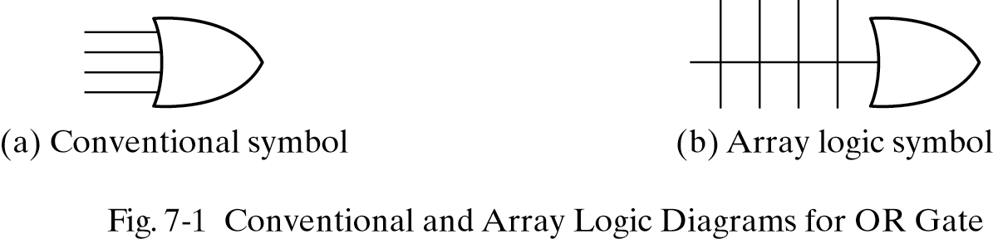
Conventional and Concise Symbols

Slide 5
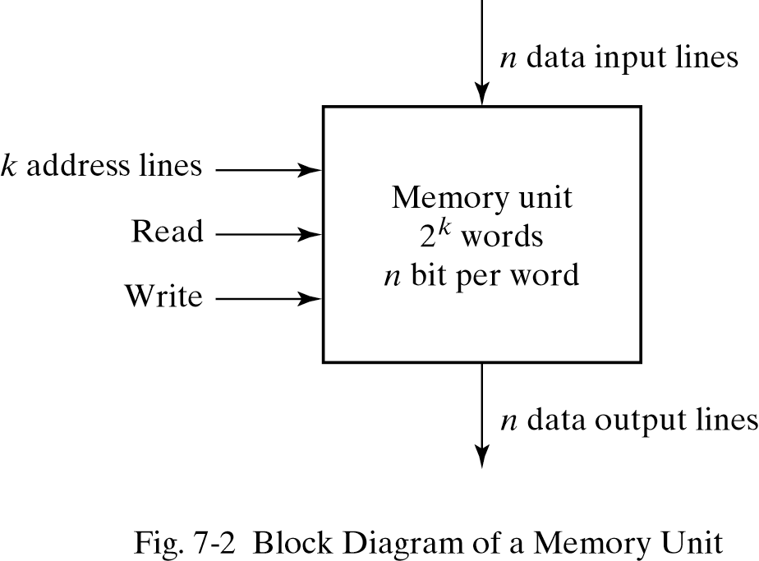
Random Access Memory
The time to transfer data in and out the device is the same
Information stored in group of bits called words.
Each word is assigned an address.

Slide 6
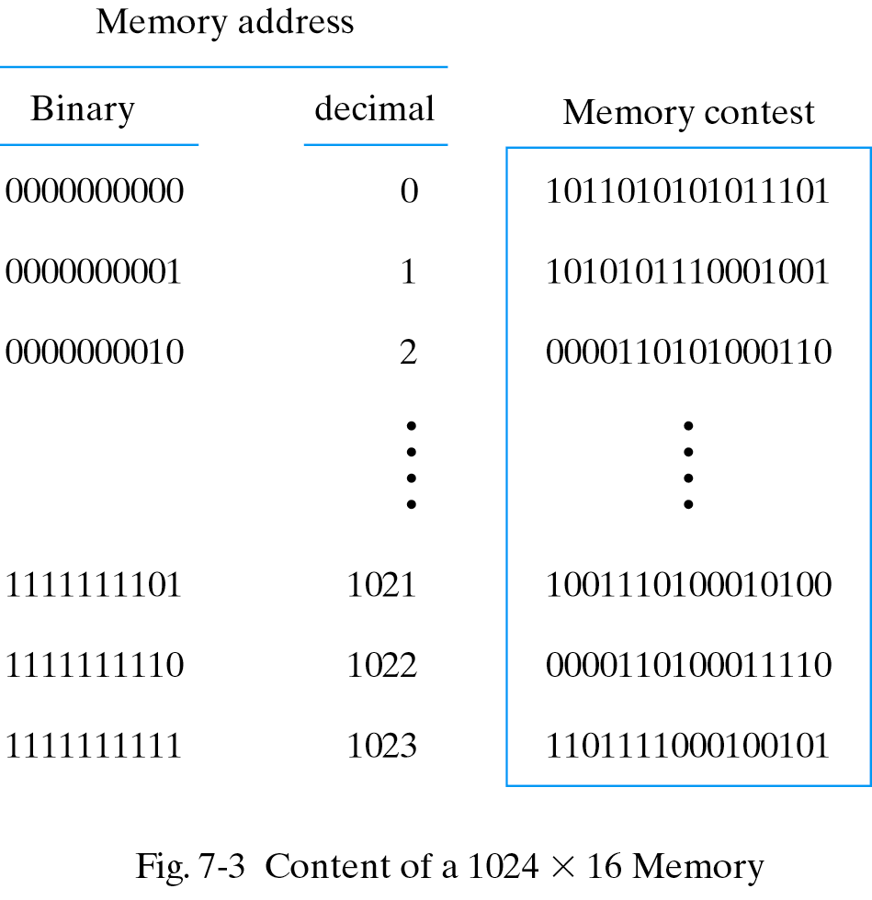
Memory Content Example
1024 memory locations: 10 bit address
16 bit data

Slide 7
Write and Read Operation
Write Operation:
1.Apply the binary address to address lines
2.Apply the data to the data lines
3.Activate the write input
Read Operation:
1.Apply the binary address to the address lines
2.Activate the read input

Slide 8
Memory Decoding
Memory Decoding: Select the memory word specified by the address
A memory with m words and n bits per word consists of m x n storage cells and decoding logic.

Slide 9
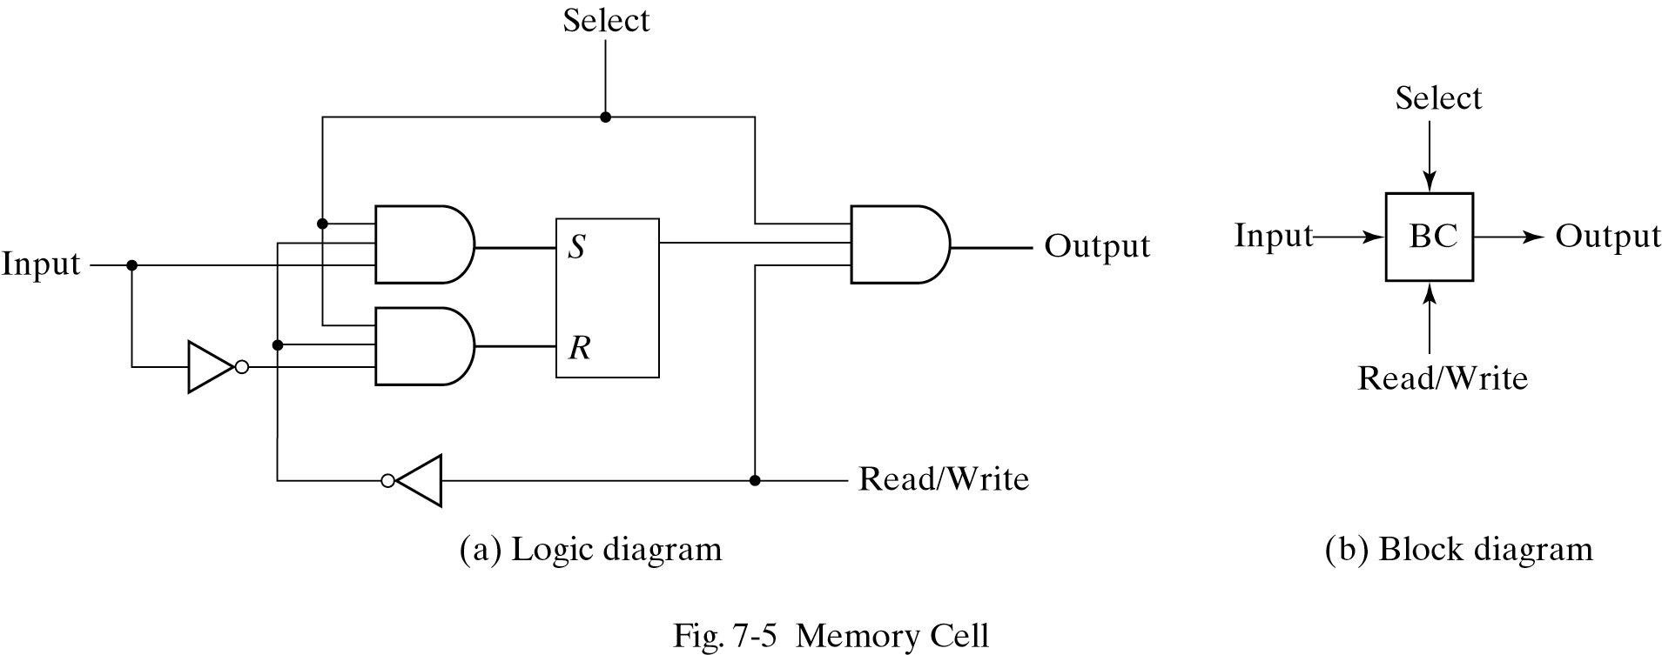
Memory Cell

Slide 10
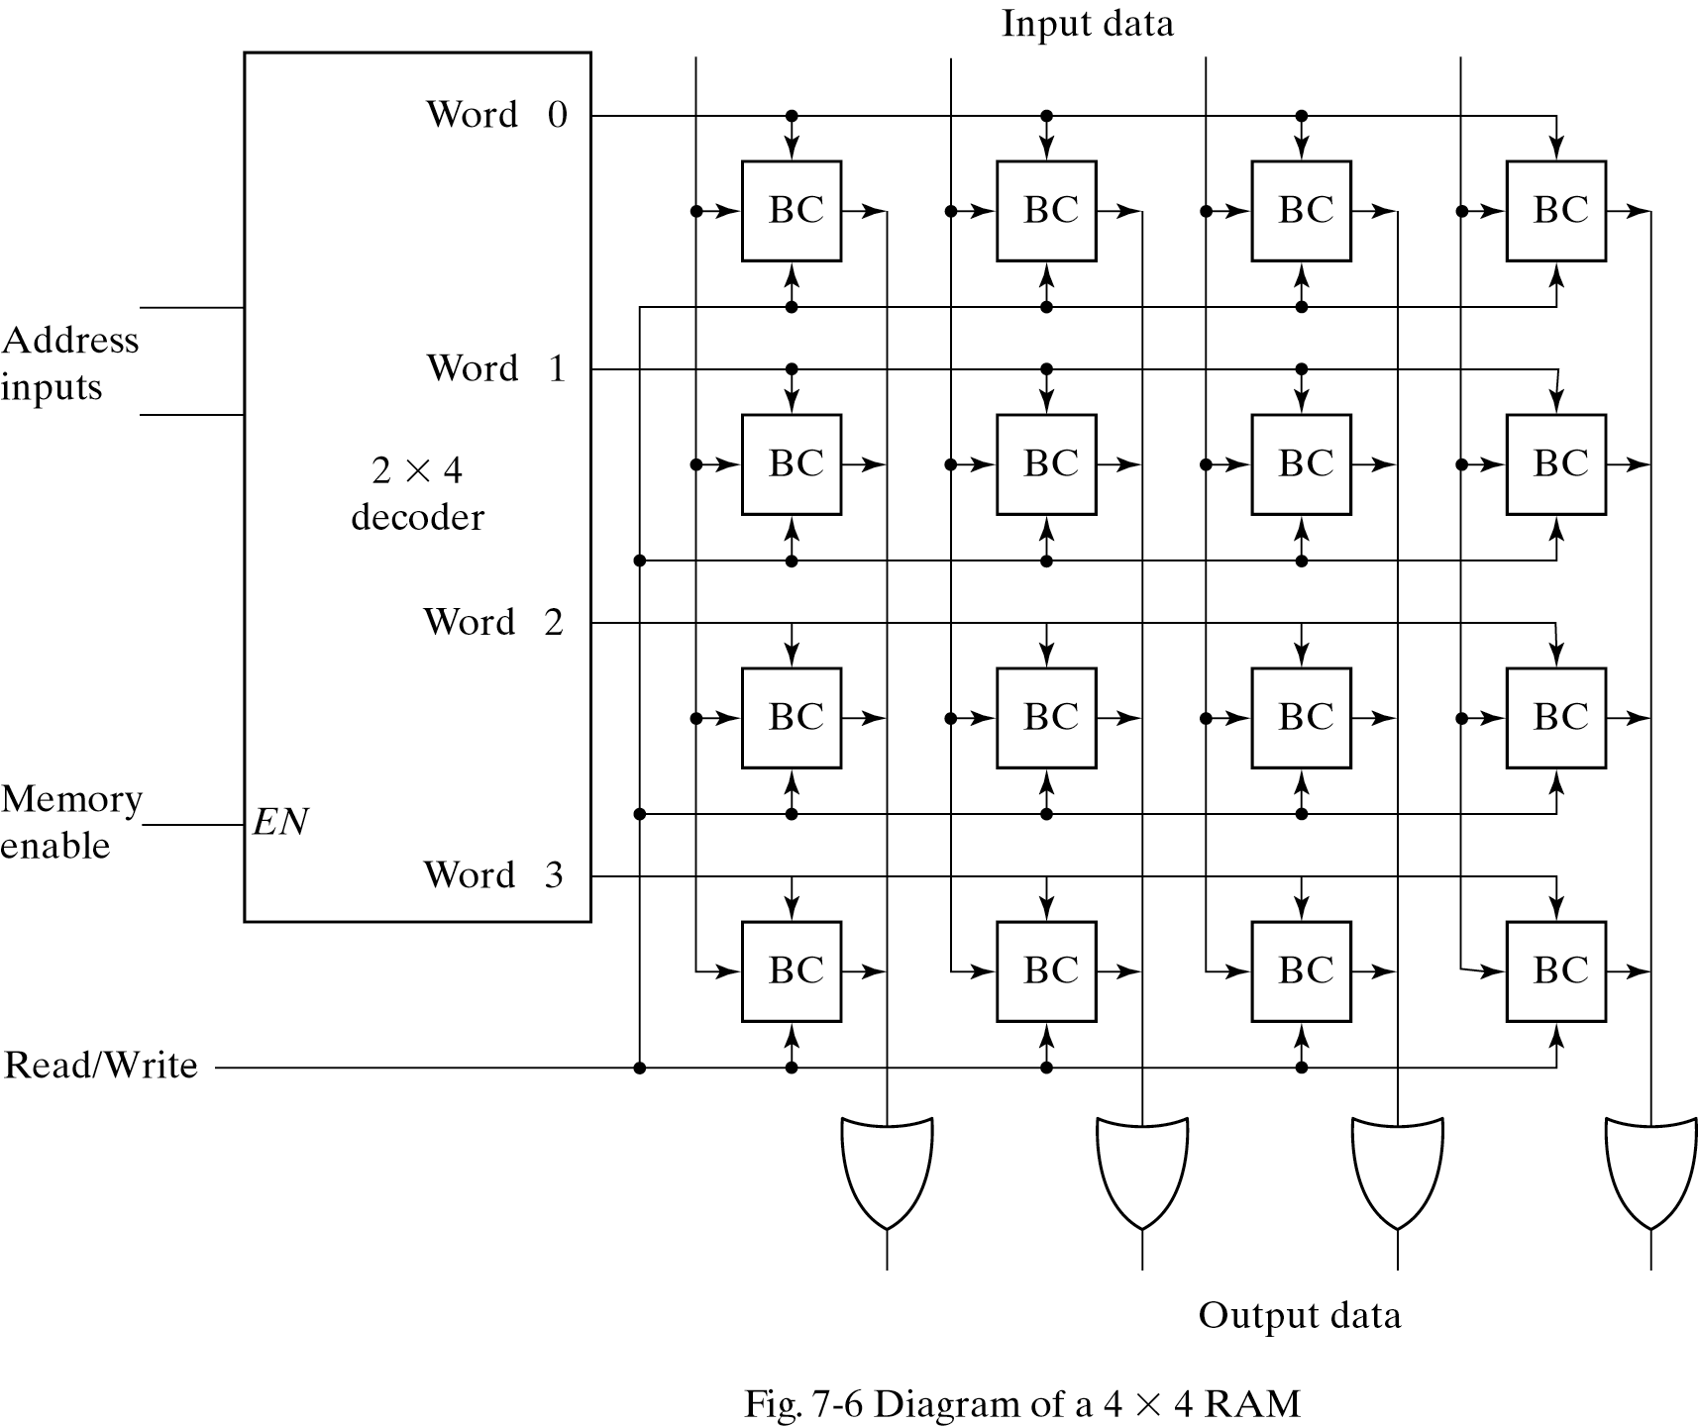
4 x 4 RAM

Slide 11
Coincident Decoding
Regular decoding is costly:
A decoder with k inputs and 2^{K} outputs requires 2^{K} AND gates with k inputs per gate.
Total number of gates can be reduced by using two-dimensional decoding:
Basic idea: arrange memory cells in a ( as close as possible to) square configuration.
Use two k/2 input decoders instead of one k input decoder

Slide 12
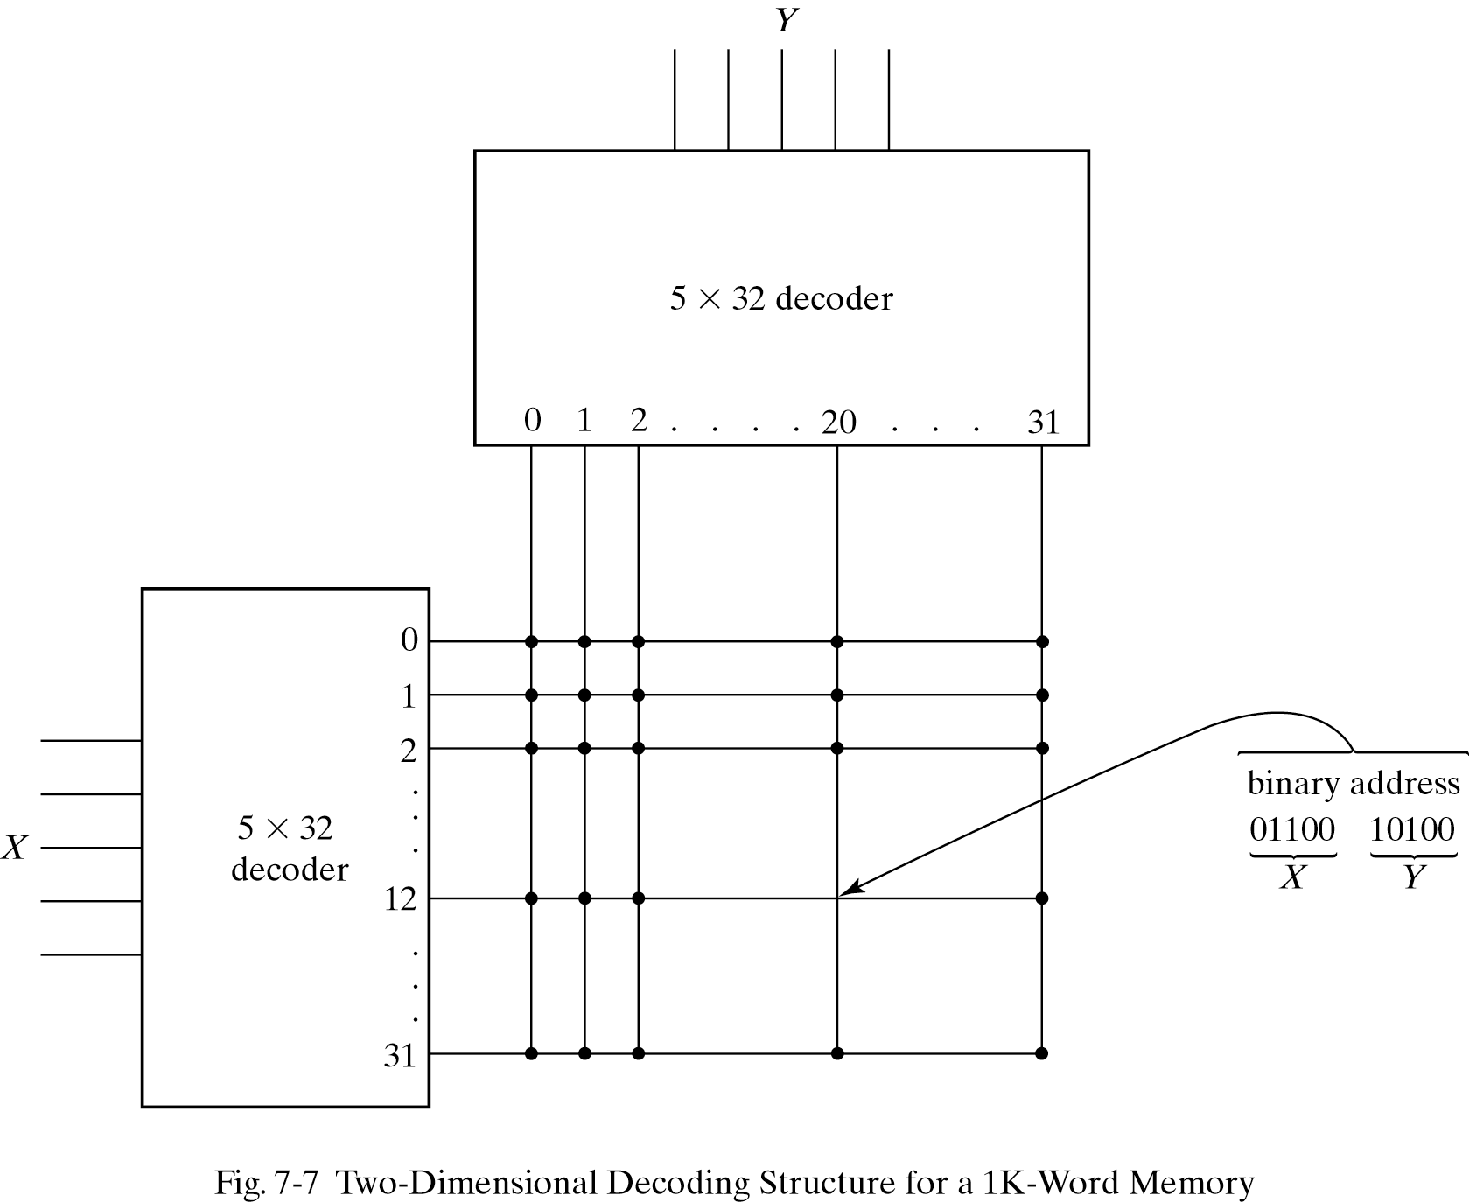
Two-Dimensional Decoding
Instead of using a single 10 x 1024 decoder
we use two 5x32 decoders.
One decoder picks the row, one the column

Slide 13
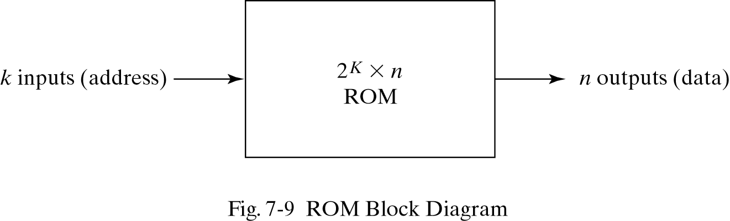
Read-Only Memory

Slide 14
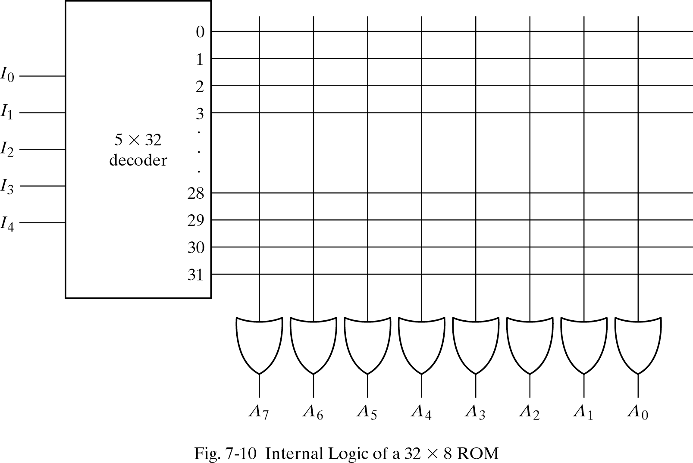
32x8 ROM
Each OR gate has 32 inputs

Slide 15
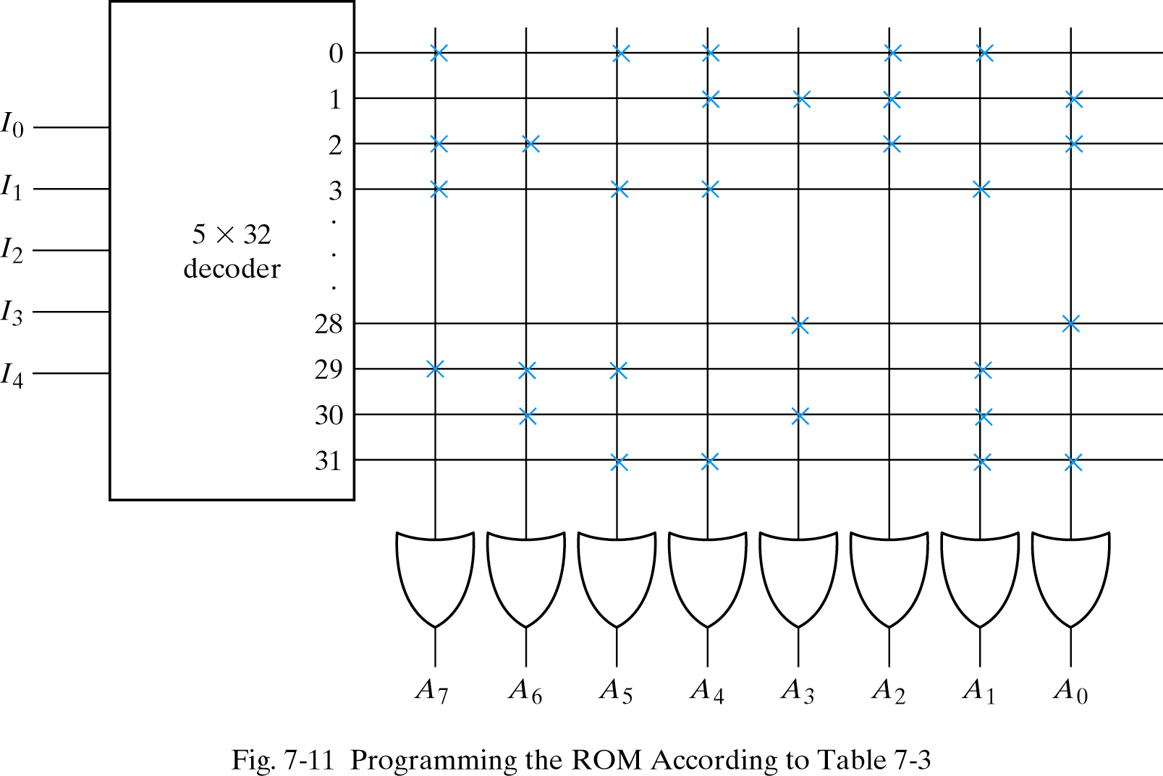
ROM Programming
1’s are connected ( x) 0’s are not.
At 00000, 10110110 is stored. At 11111, 00110011 is stored.

Slide 16
Combinational Circuit Implementation
We can assume that each output bit can be considered as a Boolean function.
Combinational circuits can be used.
Example A7(I4,I3,I2,I1,I0)= Σ(0,2,3,……29)

Slide 17
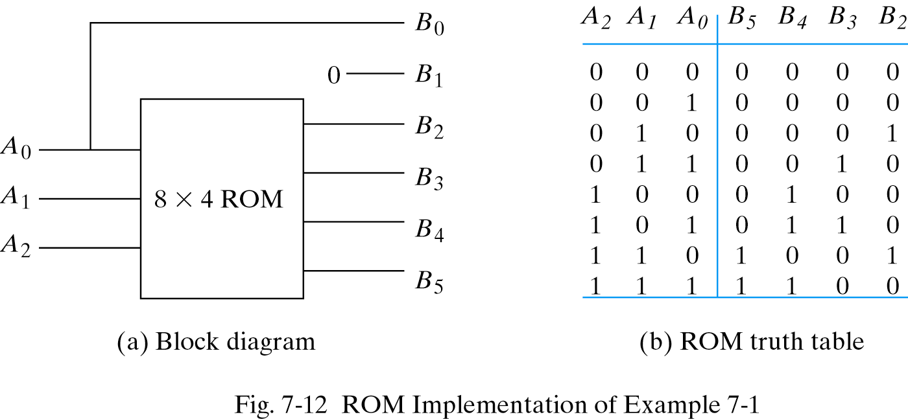
Example 7-1
Design a circuit using a ROM that accepts a 3-bit number and generates the square.

Slide 18
Combinational PLDs
A combinational PLD consists of gates divided into AND array and OR array gates to provide an AND-OR sum of product implementation.
Program Logic Array (PAL): Most flexible PLD, both AND and OR arrays are programmable

Slide 19
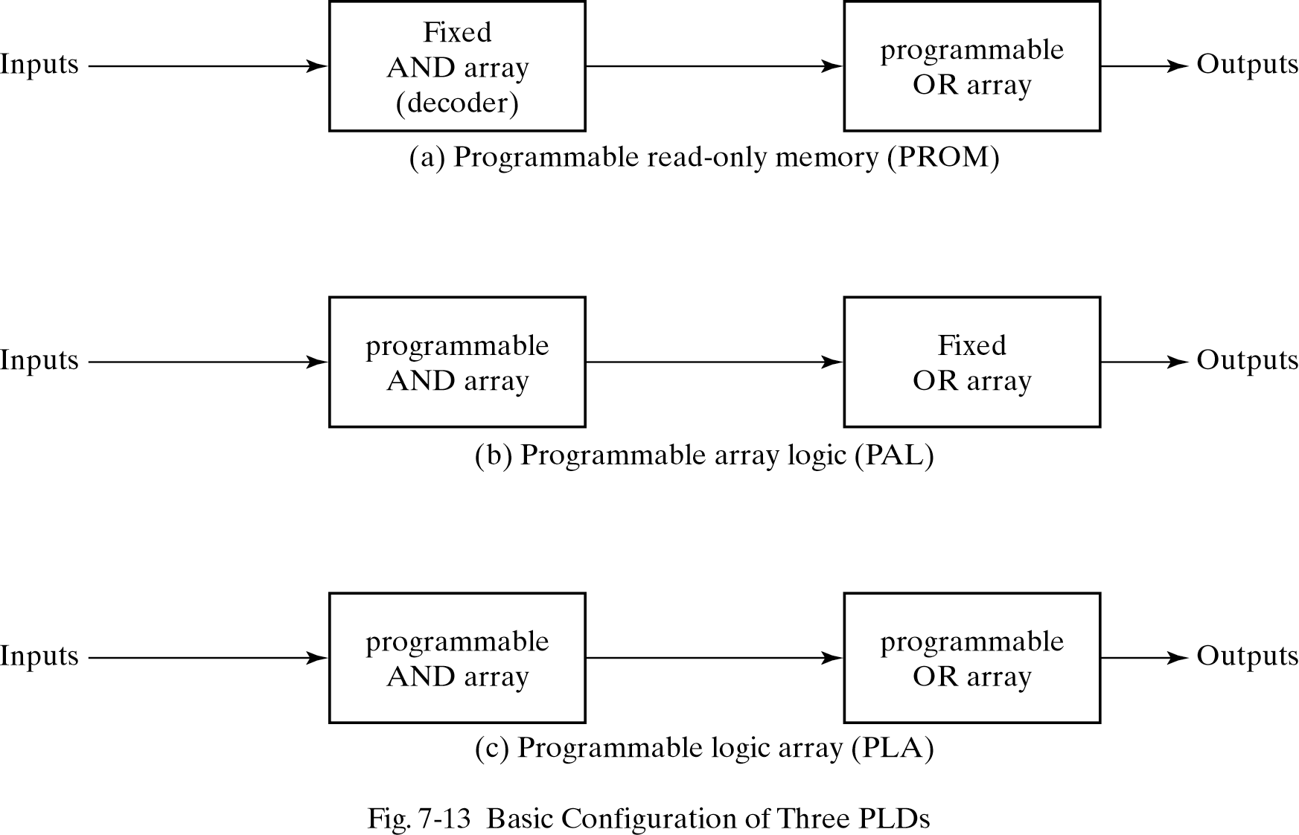
Combinational PLDs

Slide 20
Programmable Logic Array
Two differences of PLA with PROM:
1-PLA does not provide full decoding
2-PLA does not generate all minterms

Slide 21
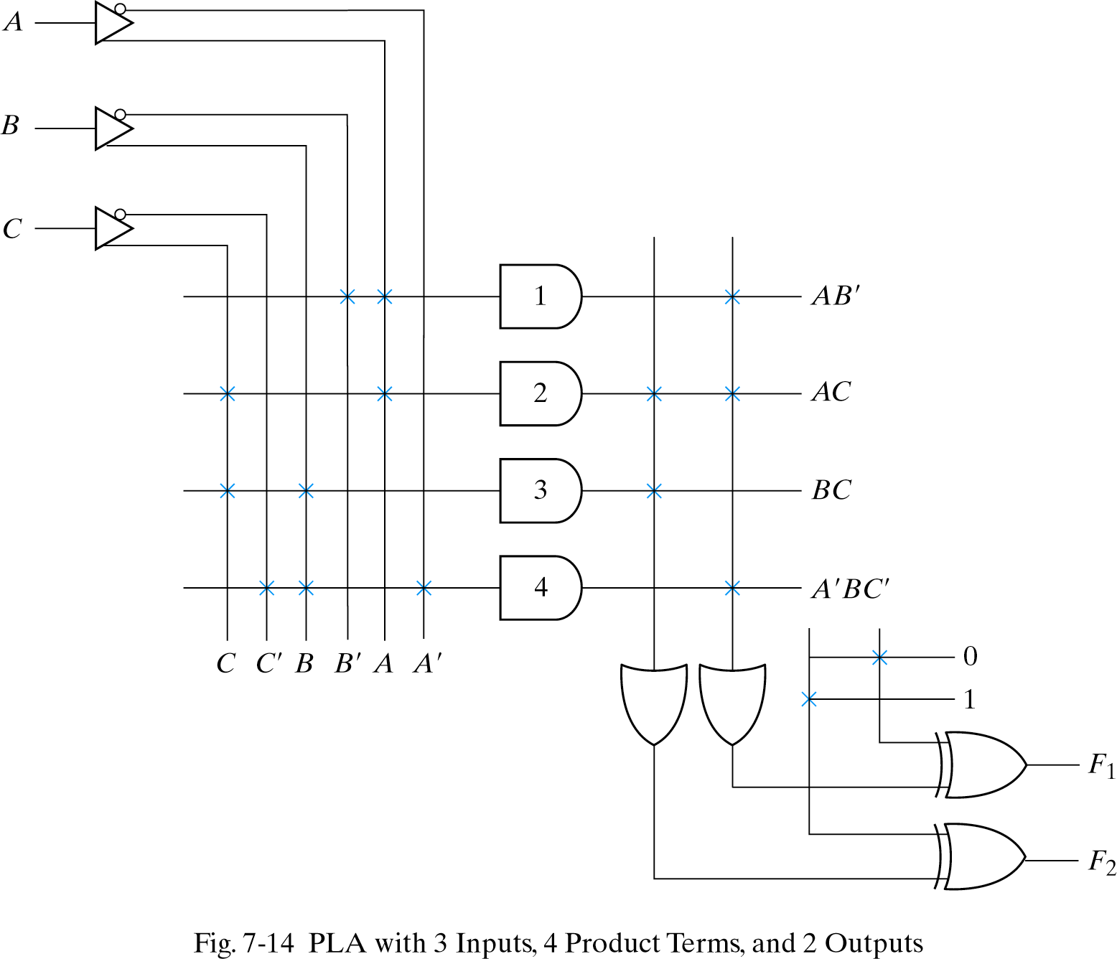
Program Logic Array (PLA)
Each input goes through
a buffer and an inverter
F1= AB’+AC+A’BC’
F2= (AC+BC)’

Slide 22
PLA Programming Table
inputs Output
T C
Product Term A B C F1 F2
AB’ 1 1 0 - 1 -
AC 2 1 - 1 1 1
BC 3 - 1 1 - 1
A’BC’ 4 0 1 0 1 -

Slide 23
Example 7-2
Implement the following two Boolean functions with a PLA
F1(A,B,C)= Σ (0,1,2,4)
F2(A,B,C)= Σ (0,5,6,7)

Slide 24
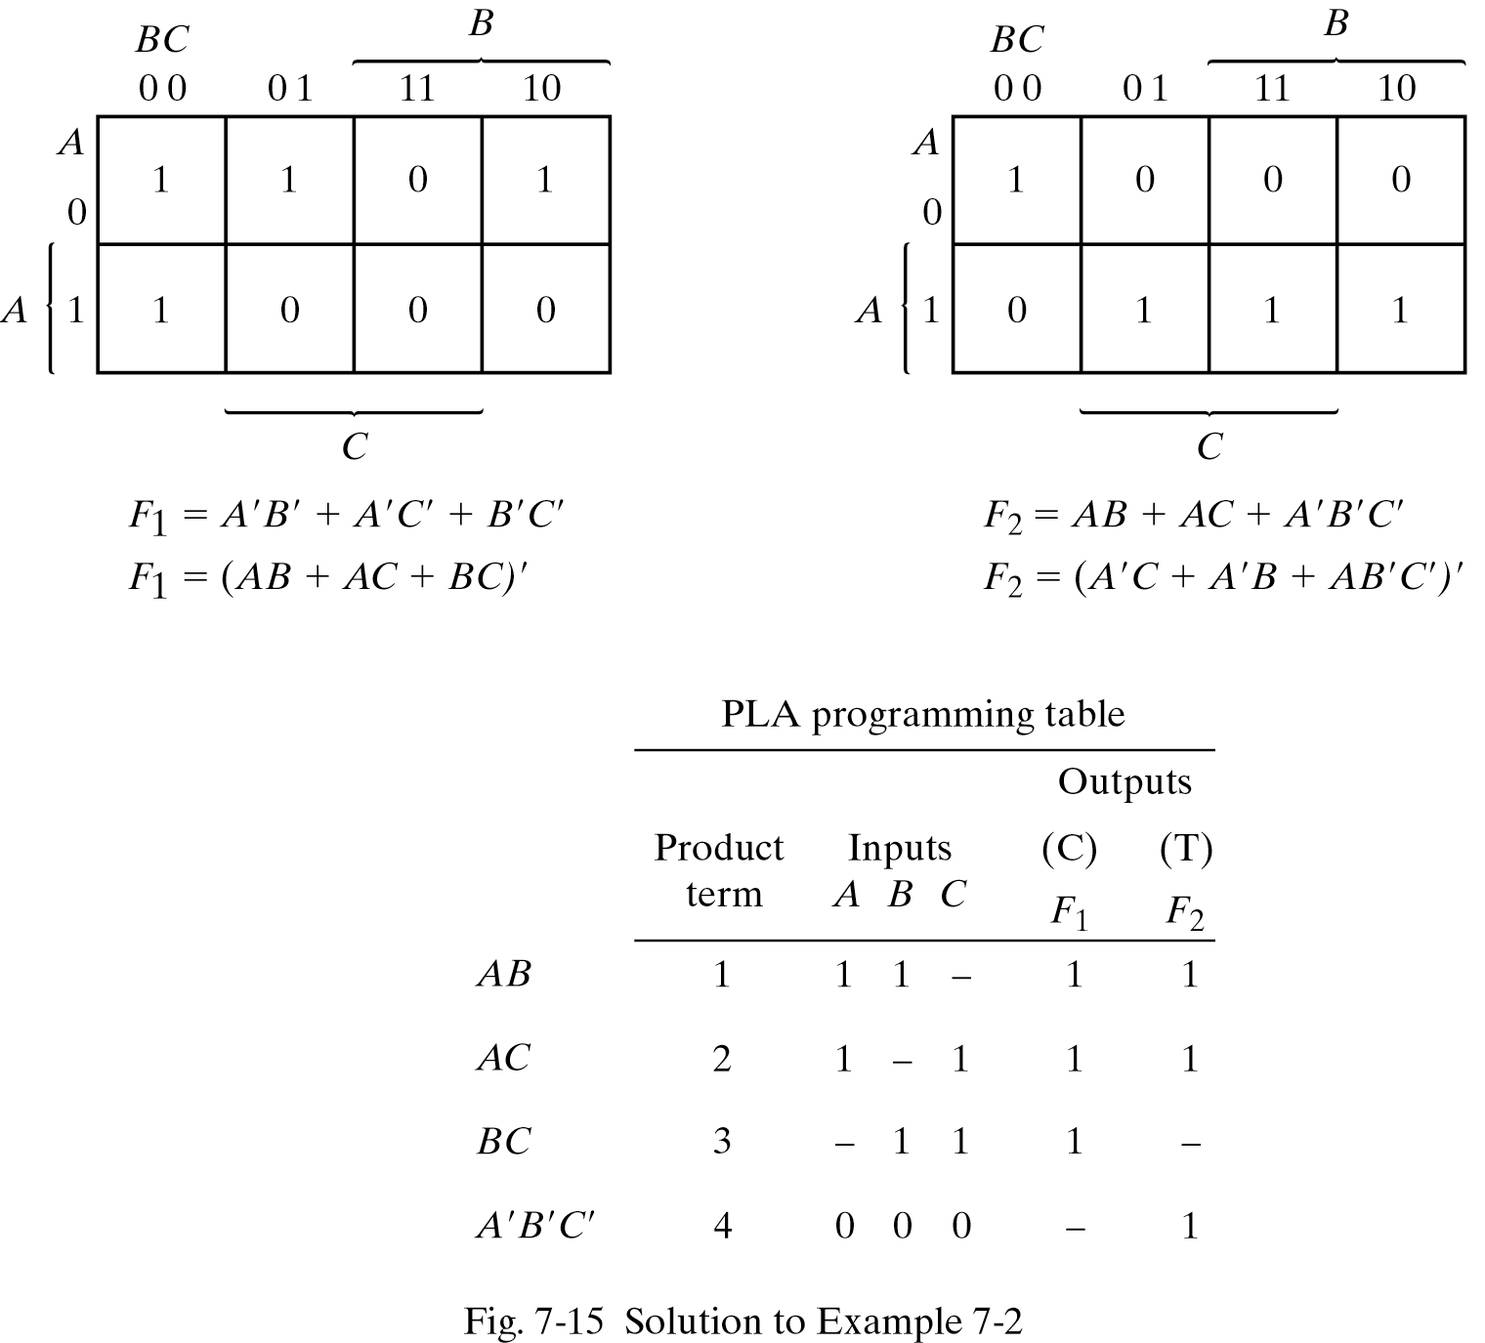
Example 7-2

Slide 25
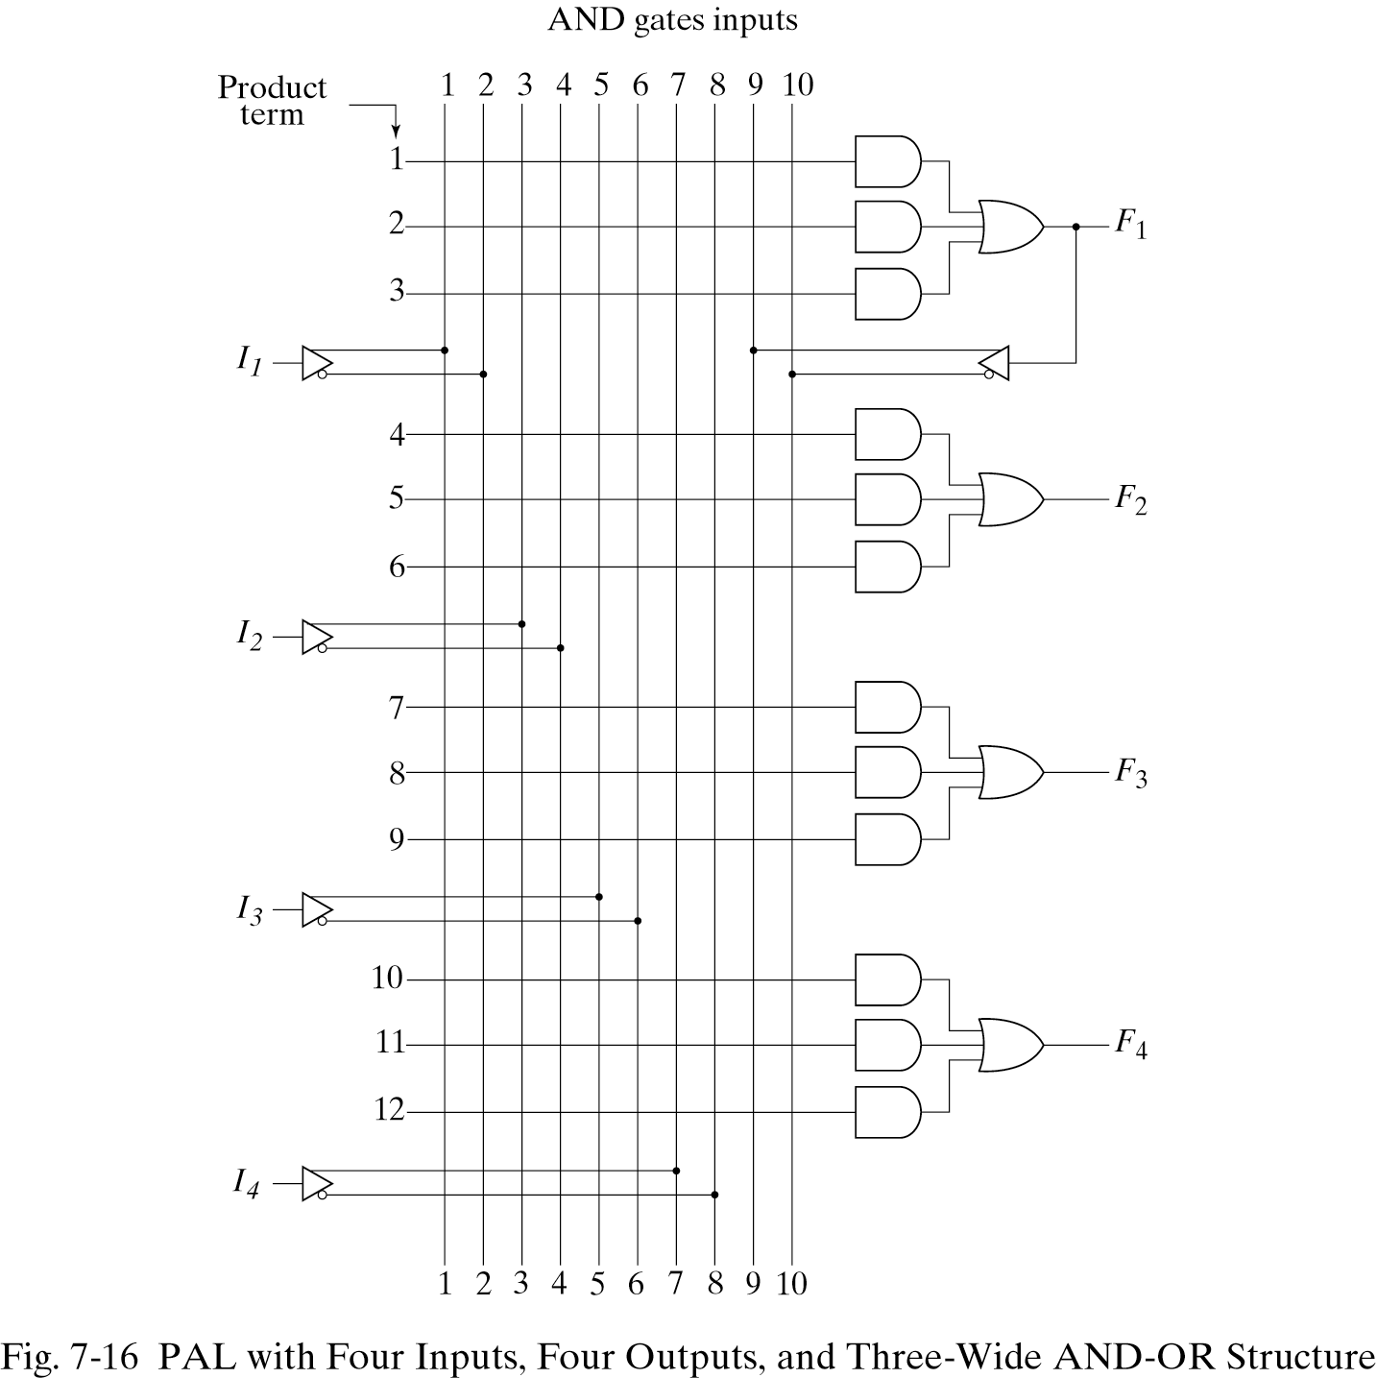
Program Array Logic (PAL)
PAL: PLD with a fixed OR array and programmable AND array.

Slide 26
Fuse Map for PAL
w(A,B,C,D)= Σ (2,12,13)
x (A,B,C,D)= Σ (7,8,9,10,11,12,13,14,15)
y (A,B,C,D)= Σ (0,2,3,4,5,6,7,8,10,11,15)
z (A,B,C,D)= Σ (1,2,8,12,13)
w=ABC’+A’B’CD’
x =A+BCD
y =A’B+CD+B’D’
z =ABC’+A’B’CD’+AC’D’+A’B’C’D
=w+AC’D’+A’B’C’D
Has four inputs, by using
w, we reduce inputs to 3.

Slide 27
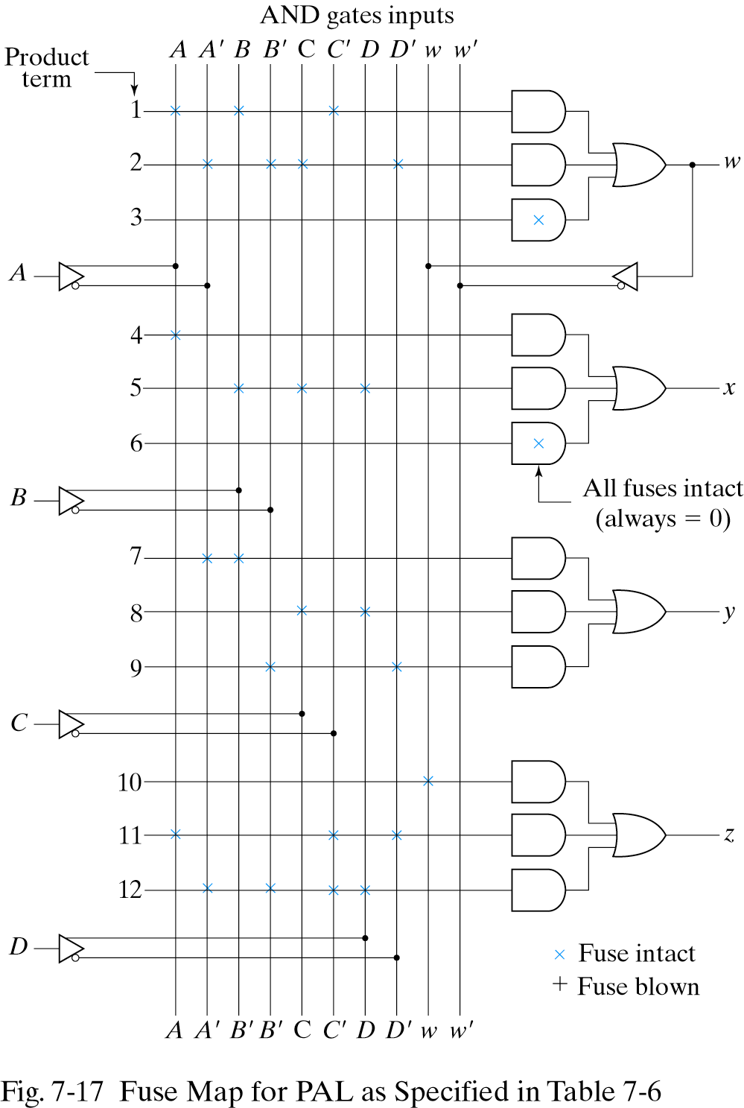
Fuse Map for PAL
w=ABC’+A’B’CD’
x =A+BCD
y =A’B+CD+B’D’
z =ABC’+A’B’CD’+AC’D’+A’B’C’D
=w+AC’D’+A’B’C’D

